Slide 1
Business Intelligence Using Tableau

Slide 2
Content
Introduction
Examples of Tableau data
Advantages
Disadvantages
Conclusion
Notes:
Use time line example

Slide 3
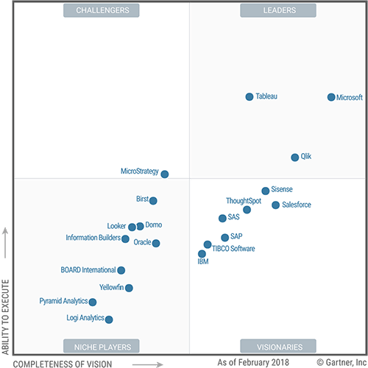
Introduction
Business intelligence is a technology-driven process for analysing data and presenting actionable information
Tableau is a popular data visualisation tool that that can perform this task
Their Goal: create a powerful data analysis tool while still being user friendly
Notes:
Use time line example

Slide 4
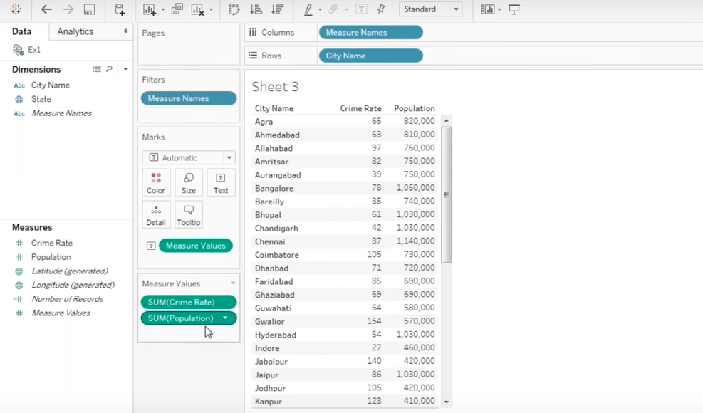

Slide 5
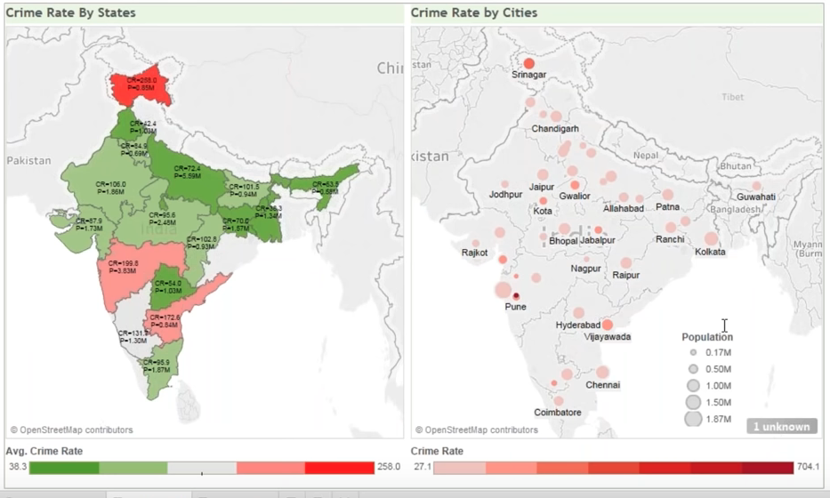

Slide 6
advantages
Data visualisation
Can handle large amounts of data
Easy to learn
User experience

Slide 7
Disadvantages
Scheduling reports
No custom visual imports
Expensive
Limited data preprocessing

Slide 8
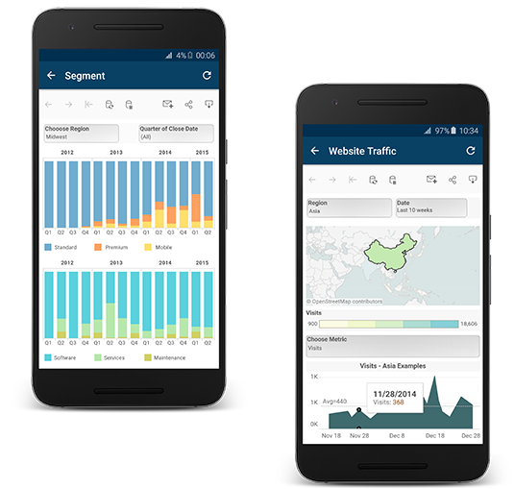
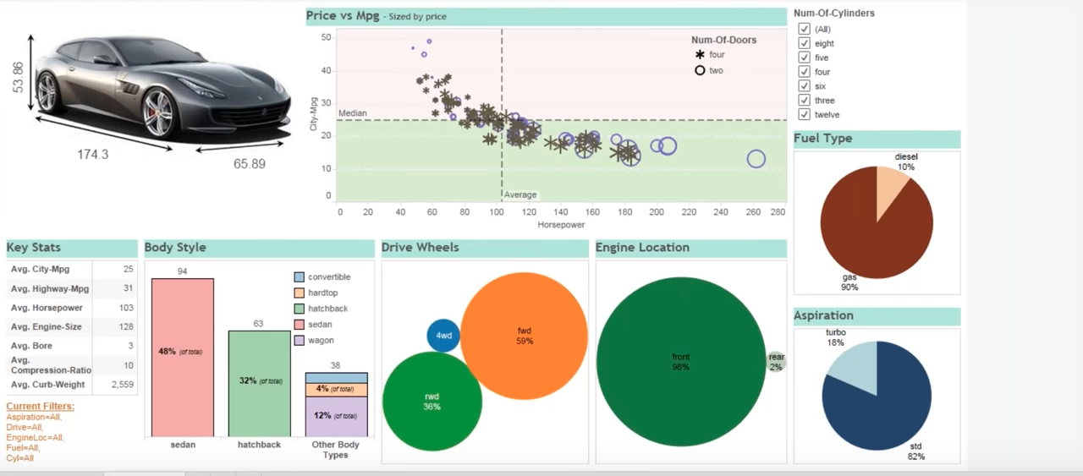
Conclusion
We have only seen a glimpse of what tableau has to offer
To be continued in week 4 …

Slide 9
QUESTIONS?

